Slide 1

Spring MVC

Slide 2
Spring Web MVC Framework
The Spring web MVC framework provides model-view-controller architecture and ready components that can be used to develop flexible and loosely coupled web applications.
The MVC pattern results in separating the different aspects of the application (input logic, business logic, and UI logic), while providing a loose coupling between these elements.

Slide 3
Spring Web MVC Framework
The Model encapsulates the application data and in general they will consist of POJO.
The View is responsible for rendering the model data and in general it generates HTML output that the client's browser can interpret.
The Controller is responsible for processing user requests and building appropriate model and passes it to the view for rendering.

Slide 4
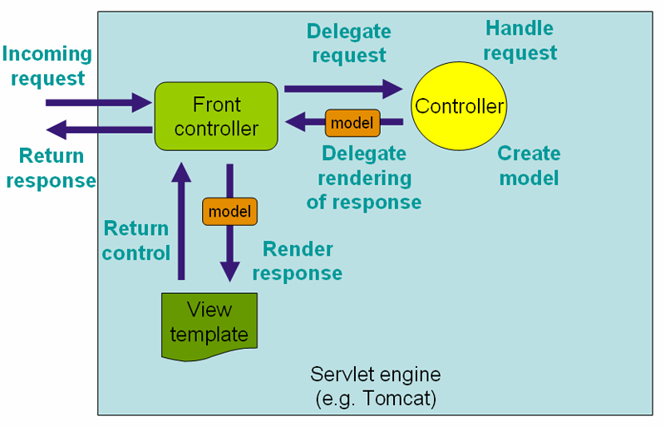
DispatcherServlet (aka Front Controller design pattern)

Slide 5

Example - RequestDispatcher example
https://github.com/vrudas/spring-framework-examples/tree/main/example-09-dispatcher-servlet

Slide 6
Spring Web MVC - Controller
DispatcherServlet delegates the request to the controllers to execute the functionality specific to it.
The @Controller annotation indicates that a particular class serves the role of a controller.
The @RequestMapping annotation is used to map a URL to either an entire class or a particular handler method. The class-level usage of @RequestMapping indicates that all handling methods on this controller are relative to his path.

Slide 7
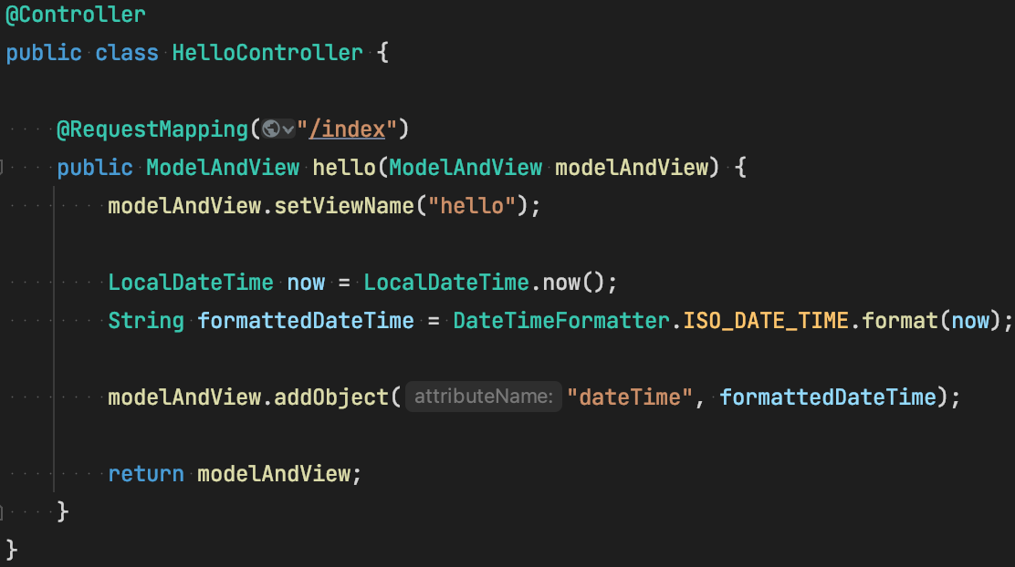
Spring Web MVC - Controller and Model

Slide 8
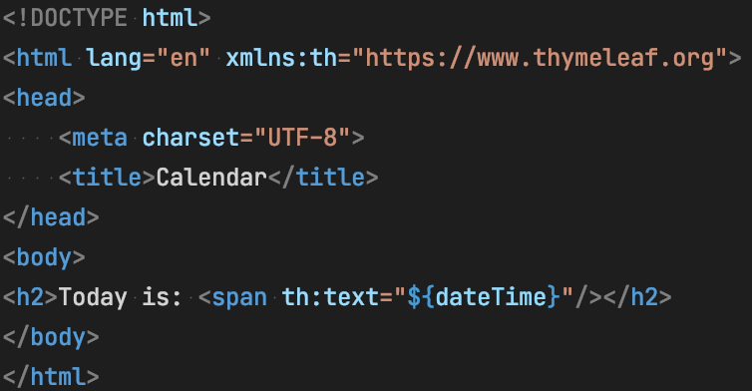
Spring Web MVC - View
Spring MVC supports many types of views for different presentation technologies. These include - HTML, XML, JSON etc. Here example of HTML template written with Thymeleaf:

Slide 9

Thymeleaf

Slide 10
Thymeleaf
Thymeleaf is a Java library
It is an XML/HTML template engine able to apply a set of transformations to template files in order to display data and/or text produced by your applications
Often used as a Back-end rendering technology for web applications
Has own dialect language to manipulate with data
More info at:
https://www.thymeleaf.org/doc/tutorials/3.0/usingthymeleaf.html
https://www.baeldung.com/thymeleaf-in-spring-mvc

Slide 11
@RequestMapping - Details
URI templates can be used for convenient access to selected parts of a URL in a @RequestMapping method.
A URI Template is a URI-like string, containing one or more variable names. When you substitute values for these variables, the template becomes a URI.
For example, the URI Template http://localhost:8080/users/{userId} contains the variable userId. Assigning the value 123 to the variable placeholder provide http://localhost:8080/users/123.

Slide 12
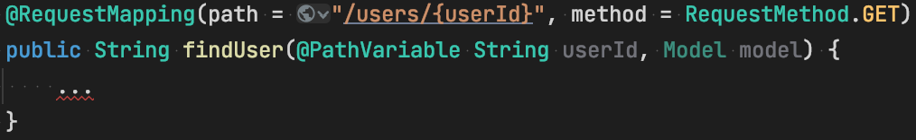
@RequestMapping - Details

Slide 13
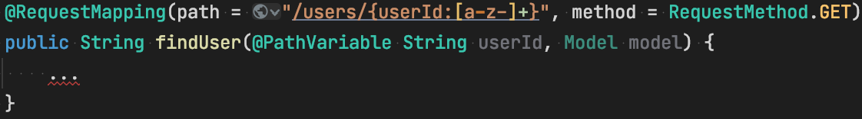
@RequestMapping - Details

Slide 14
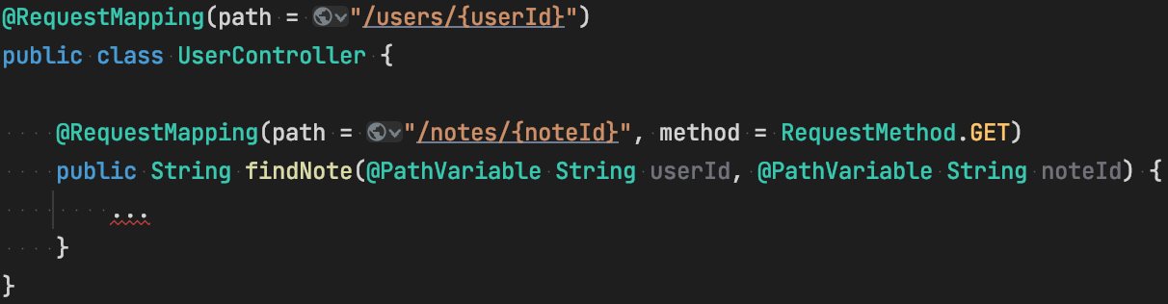
@RequestMapping - Details

Slide 15
Example - Spring Web MVC
https://github.com/vrudas/spring-framework-examples/tree/main/example-10-spring-mvc

Slide 16

Spring Boot

Slide 17
Spring Boot

Slide 18
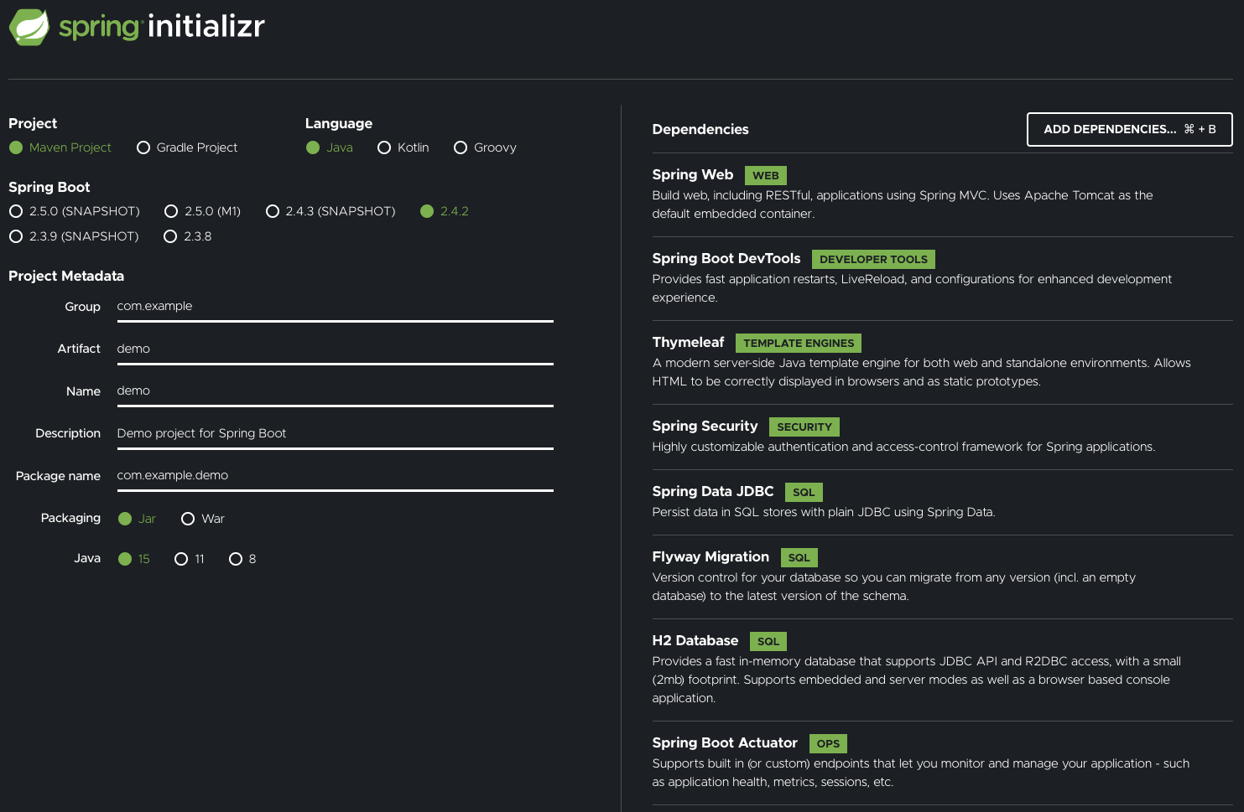
Spring Boot Starters (https://start.spring.io/)

Slide 19
Example - Spring Boot
https://github.com/vrudas/spring-framework-examples/tree/main/example-11-spring-boot

Slide 20
Notes Application
📓🗒📔💻

Slide 21
Example - Notes Application
https://github.com/vrudas/spring-framework-examples/tree/main/notes-app

Slide 22
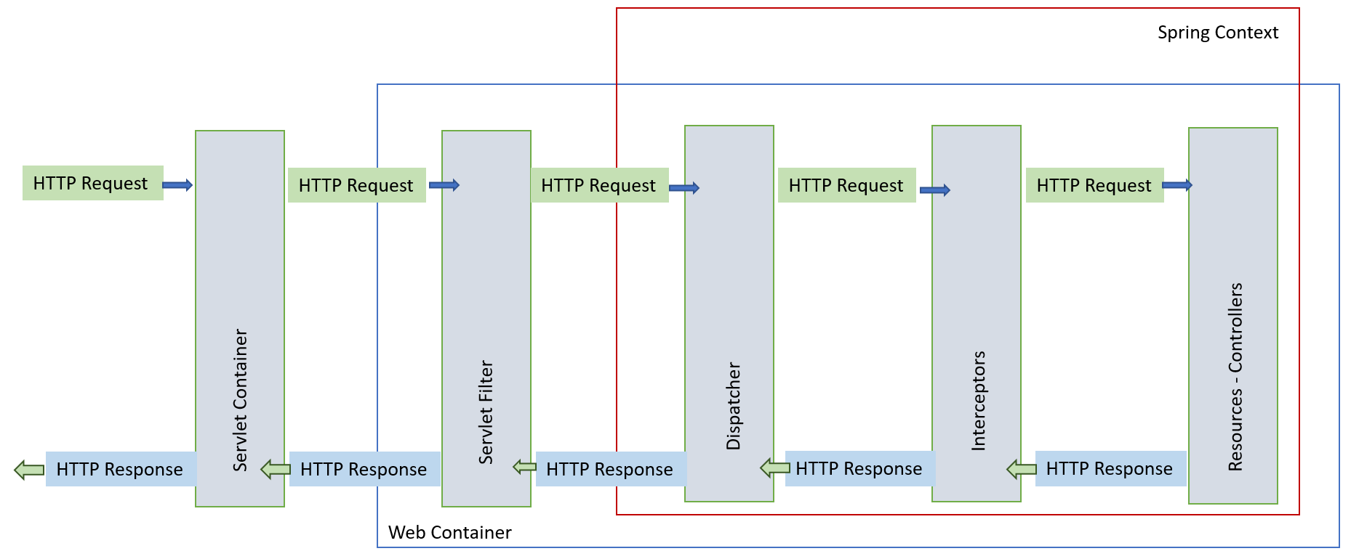
Request Interceptor

Slide 23
Example - Interceptor
https://github.com/vrudas/spring-framework-examples/blob/main/notes-app/src/main/java/io/sfe/notesapp/web/common/LoggerInterceptor.java

Slide 24

Error Handling

Slide 25
Example - Error Handling
https://github.com/vrudas/spring-framework-examples/blob/main/notes-app/src/main/java/io/sfe/notesapp/web/common/ControllerExceptionHandler.java

Slide 26
Any questions?
🤔

Slide 27
Homework
Migrate StudentsRegistry (both Web and Console) app to Spring Boot autoconfiguration
Replace usage of Servlet API to a flexible Spring MVC
Use Thymeleaf as a Template Engine for HTML views
Handle all error types by custom controller advice
Important note Login/Logout functional should not use Spring Security
Next lesson will be practice

